Slide 1
Pastoral Care in a Increasingly Secular Society ...
Next steps for the Ontario Provincial Synod, October 11, 2012
The Transitional Council of the College of Registered Psychotherapists and Registered Mental Health Therapists of Ontario (CRPRMHTO) and its impact upon chaplaincy and pastoral counselling.

Slide 2
Context:
In response to the Ontario Government’s decision to regulate that part of the health care sector which provides mental health services, the government decided to create a profession college which would regulate the practice of pyschotherapy and mental health therapy;

Slide 3
The function of the new College, once fully operational, will be to regulate Registered Psychotherapists and Registered Mental Health Therapists in the public interest, striving to ensure that practitioners are competent, ethical and accountable. Once the Psychotherapy Act is proclaimed and the College is functioning, some members of the governing Council (a small majority) will be elected by College members, and others will be appointed by government.

Slide 4
Context:
The new College, once fully operational, will regulate psychotherapists and mental health practitioners ensuring that practitioners are competent, ethical and accountable.
The Canadian Association for Pastoral Practice and Education (CAPPE), now known as the Canadian Association for Spiritual Care (CASC) remains the principle educational organization for chaplains. CASC will become a sub-group of the College and as such will require its membership to become members of this new College.

Slide 5
The risk?
That hospitals, long-term care and extended care facilities may (may not) require staff chaplains, and community clergy, to have membership in this College.
That parish clergy will be restricted in the scope and nature of their pastoral counselling to members of their congregations, (and others).

Slide 6
At present:
CRPRMHTO has drafted;
* College Registration Regulations
* Professional Misconduct Regulations
* proposed definitions of what constitutes psychotherapy (vs. for example pastoral counselling)
* Competency Profiles
CRPRMHTO has receiving written stakeholder comments, (July 29-Sept. 27, 2011).
CRPRMHTO hopes to be functional by April 2013. There will be a grace period to grandfather current practitioners/chaplains into the College.

Slide 7
At present:
The Venerable Dr. Harry Huskins, in consultation with Provincial Chancellor Christopher Riggs has written to Joyce Rowlands, CRPRMHTO Registrar expressing our concern “that clergy will be able to continue to perform their traditional functions of providing counselling and spiritual care without impediment under the legislation.”

Slide 8
The Provincial Synod will continue to monitor and advocate for
full and free access under the Ontario Human Rights Code be maintained for community clergy to ensure adequate religious/pastoral care to members of all faith communities
that faith communities have the freedom to “appoint” and sustain faith based chaplaincies within government human service facilities without necessarily having such chaplaincies be members of the CRPRMHTO
that CRPRMHTO registration regulations accommodate appropriate and adequate equivalences other then CASC

Slide 9
Our concerns remains that:
Greater due diligence will need to be taken by Dioceses to more clearly
and consistently define what constitutes pastoral care and counselling
and that ongoing education must be exercised to ensure all clergy
remain within those definitions unless ....
* clergy who wish to engage psychotherapeutic methodologies into their ministries join the (professional) College
* or Dioceses require that their clergy join the College if they intend to “do more than” simply pastoral care, otherwise there may be exposure to the risk of legal action against those who practice outside the scope of a professional college.

Slide 10
Our concerns remains that:
It can be assumed that health care facilities will seek chaplains who are members of the College. Therefore, professional chaplains will need to ensure additional training as required by the College. Dioceses will need to determine if they will support this additional training.
Hospitals, prisons and other government funded human service facilities may inadvertently “lock out” clergy who are not members of this College as regards the delivery of religious/pastoral care.

Slide 11
Definitions ...
and exemptions

Slide 12
CRPRMHTO
Will prohibit anyone who is not a member of the College (or one of the other authorized Colleges) from holding himself or herself out as a person who is qualified to practice psychotherapy or mental health therapy in Ontario.

Slide 13
Psychotherapy - Scope of Practice
The practice of psychotherapy is the assessment and treatment of cognitive, emotional or behavioural disturbances by psychotherapeutic means, delivered through a therapeutic relationship based primarily on verbal or non-verbal communication.

Slide 14
Controlled Act (pared down)
“…treat, by means of psychotherapy technique …an individual’s serious disorder that may seriously impair his or her judgement, insight, behaviour, communication or social functioning.”

Slide 15
HPRAC Definition (Difference between Counselling & Psychotherapy)
“The practice of psychotherapy is distinct from both counselling, where the focus is on the provision of information, advice-giving, encouragement and instruction, and spiritual counselling, which is counselling related to religion or faith-based beliefs.”

Slide 16
Exemption from the Act
The prohibition against performing Controlled Acts does not apply when “treating a person by prayer or spiritual means in accordance with the tenets of the religion of the person giving the treatment…”

Slide 17
a further exemption
The restriction on performing a Controlled Act also does not apply to communication made in the course of counselling about emotional, social, educational and spiritual matters.

Slide 18
DEFINITION OF SPIRITUAL / RELIGIOUS COUNSELLING
Faith traditions and communities often speak of spiritual, religious or pastoral counseling as occurring within the context of ministry. Ministry is not an abstraction. Ministry is exercised by people and within relationships that are situated in a particular place and a particular time within the milieu or organization of a faith tradition and community. (R. R. Gaillardetz, Towards a Contemporary Theology of the Diaconate: Worship. Vol. 79, #5, Sept. 2005.)

Slide 19
DEFINITION OF SPIRITUAL / RELIGIOUS COUNSELLING
Spiritual, pastoral and religious counseling is distinct from other forms and methods of psychotherapy because of the assumed spiritual or religious dynamic within the counseling therapeutic relationship. There is the underlying faith assumption of the pastoral or religious counselor and the assumed presence of a spirituality within the approach of the spiritual counselor.
September 21, 2005
Reverend Canon Douglas Graydon

Slide 20
Ministry (Care) includes those roles deemed essential to the function of a church or community of faith. Traditionally, such roles are rooted in and derived from the public ministry of Jesus Christ. Literally, ministry derives from the Greek word diakonia – the feeding and care of guests. The action of ministry suggests the dynamic of employing the various gifts, which God bestows, upon the members of the community for the needs of the community.

Slide 21
The role of pastor is modelled after that of shepherd. That is the administering, caring for, managing and watching over the flock, or congregation.
A model of ministry might be Henry Nouwen’s “ministry of presence” or that of a “servant” or that of a “companion in faith.”
All are fraught with ambiguity

Slide 22
Approaches to Pastoral Counselling include:
Brief Client Centered Pastoral Counselling: a directive, client centered time limited counseling style facilitating the setting of goals for behavioural change without necessarily seeking resolution of clients concerns
Strategic Pastoral Counselling: a focus upon “being with” the client – an incarnational process of discerning the spirit within the journey
Pastoral Counselling and Motivational Interviewing: a directive, client centered counseling style for eliciting behaviour change by helping clients explore and resolve ambivalence
Biblical Pastoral Counselling: wrong actions/feelings/attitudes – false beliefs-true beliefs-right actions-changed behaviour/attitudes/thinking
Coaching / Pastoral Counselling Model: focus upon five areas – spiritual, emotional, mental, physical, social –note illustration

Slide 23
Therefore, religious/spiritual/pastoral counselling is primarily supportive in nature and content. Individuals whose needs exceed supportive counselling must be referred to appropriate qualified professionals.

Slide 24
Recommendation
That the Provincial Synod support a working group to educate clergy regarding;
* the definitions differentiating psychotherapy and pastoral counselling, (spiritual / religious care), * the legal scope of practice as determined by CRPRMHTO
* the implications upon pastoral care.
Example: Momentum – Diocese of Toronto

Slide 25
Help me, O God, to look into the Distance, while I am here Now

Slide 26
Chaplaincy services at Mount Sinai Hospital
Text

Slide 27
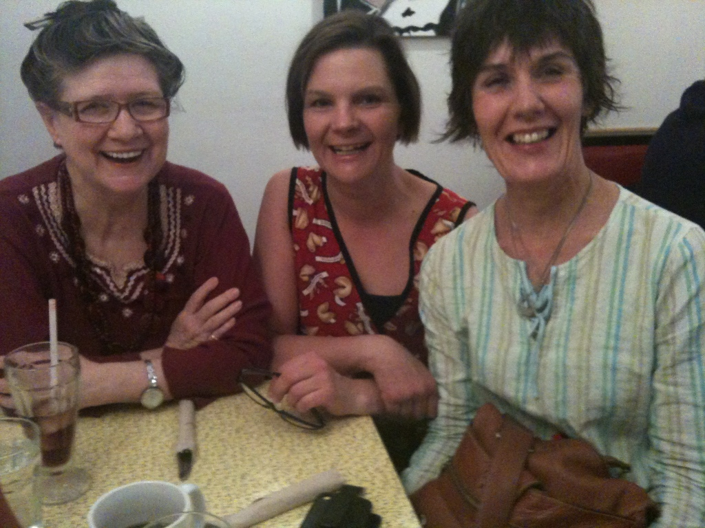
The Chaplains of:

Slide 28
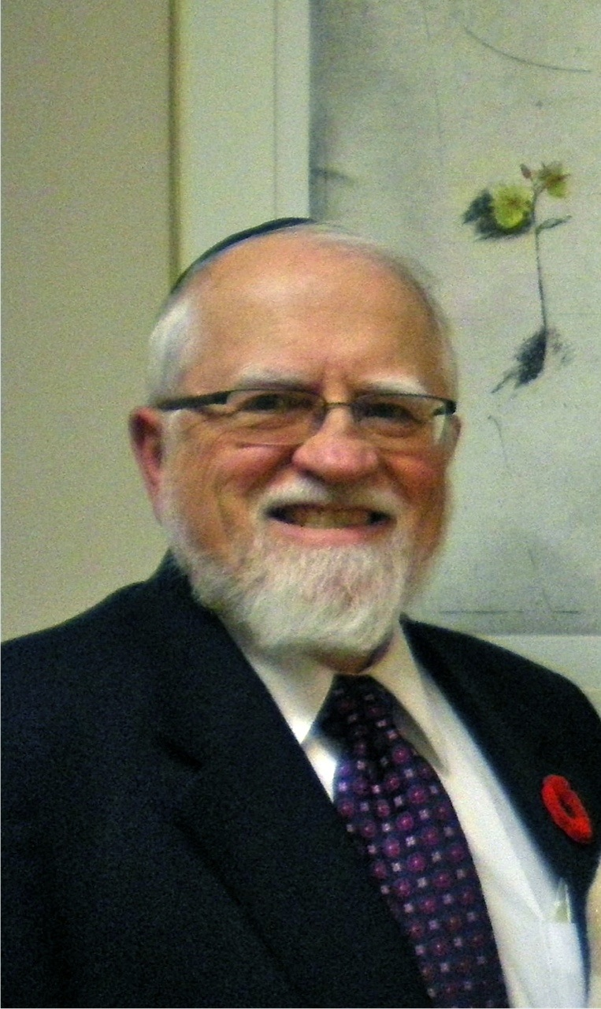
The Rabbi... the Director of Chaplaincy:

Slide 29
Our patients, families and staff: the diversity of the cosmos (the household) of God.

Slide 30
The story of surrounding hospitals in the city and chaplains:
Princess Margaret Hospital
Toronto General Hospital
Toronto Rehab
Toronto General Hospital
Women’s College Hospital
Holland Orthopaedic & Arthritic Centre
St. Michael’s Hospital
The Hospital for Sick Children

Slide 31
What’s in a name?
Spiritual Care Professional
Spiritual Care Provider
Spiritual Care Psychotherapist
Chaplain

Slide 32
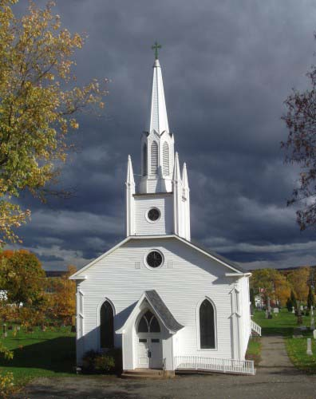
What is happening in the suburbs and rural areas?
Perhaps one chaplain
Community clergy

Slide 33
What do the hospital administrations understand or know about chaplains?
The hospitals know very little but they have certain assumptions...
Who will guide the hospitals, offer the options and teach about religious and spiritual care?

Slide 34
Religious and Spiritual Care

Slide 35
Religious and Spiritual Care
Assumptions and Presumptions.
Good and Bad.
What do we offer?
Being faithful and hopeful in the world.

Slide 36
Religious and Spiritual Care

Slide 37
Religious and Spiritual Care: Being a Chaplain
HEALING IN
JOY & SORROW
AND
A SURE AND CERTAIN HOPE

